Slide 1
Innovative test solution
Provider
- Probe pin Datasheet -

Slide 2
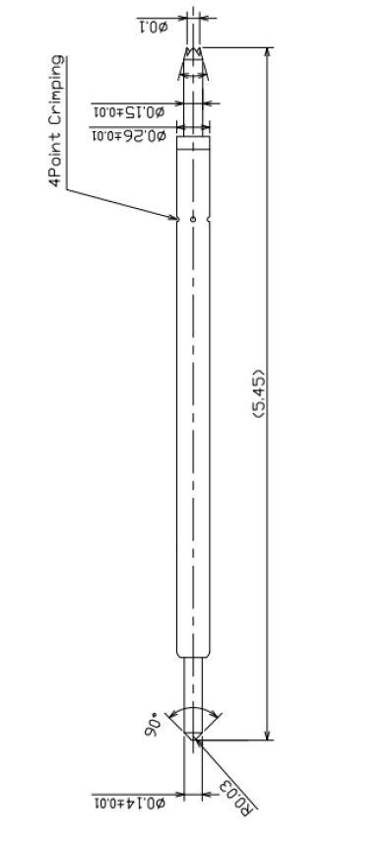
※ POGO type – 0.35 pitch
IVB-SAR-545-026-A241-00
Pitch | 0.35mm
Total Length | 5.45mm
Use Length | 5.05mm
Use Stroke | 0.4mm
Recommended Top Plunger Stroke | 0.15mm
Recommended Bottom Plunger Stroke (Pre-load) | 0.25mm
Max Stroke | 0.55mm
Spring Force at Use Stroke | 20gf at 0.4mm Stroke
Operating Temperature | -45 to 200°C
DC Resistance | Avg. 65.0 mΩ under
Current Rating | 4.0A
Self Inductance | 1.1 nH
Bandwidth @ -1dB | 20.0 GHz
Capacitance | TBD
Top Plunger | BeCu / Au over Ni
Bottom Plunger | BeCu / Au over Ni
Barrel | Alloy / Au over Ni
Spring | SUS / Au over Ni
Insertion Life | 100,000 cycles at 0.4mm Stroke

Slide 3
※ Current test
Applied time 2 mins
Decrease in threshold spring force: 20%
Duty ratio | On | Off | Max Current
1.0 | Continuous |  | 4.0 A
0.5 | 0.1 sec | 0.1 sec | 6.0 A
0.1 | 0.1 sec | 0.9 sec | 8.5 A
0.01 | 0.1 sec | 9.9 sec | 9.5 A

Slide 4
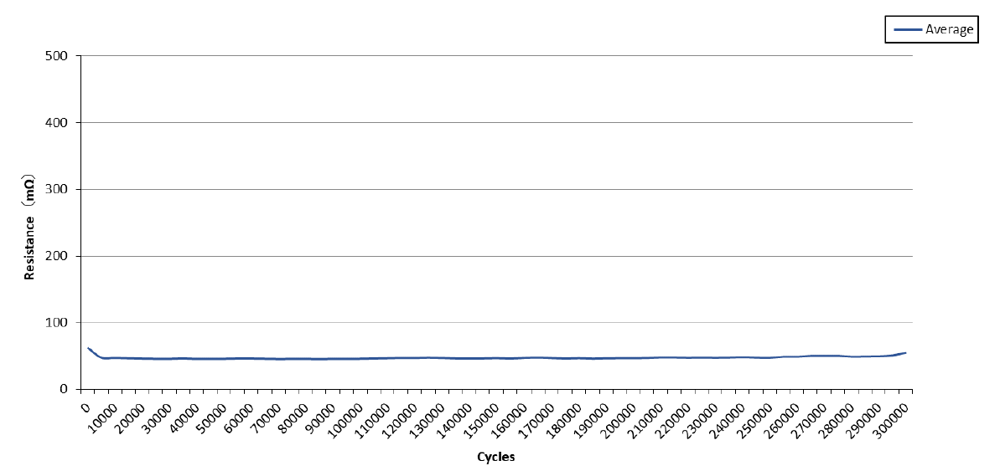
※ Resistance test with life cycle test

Slide 5
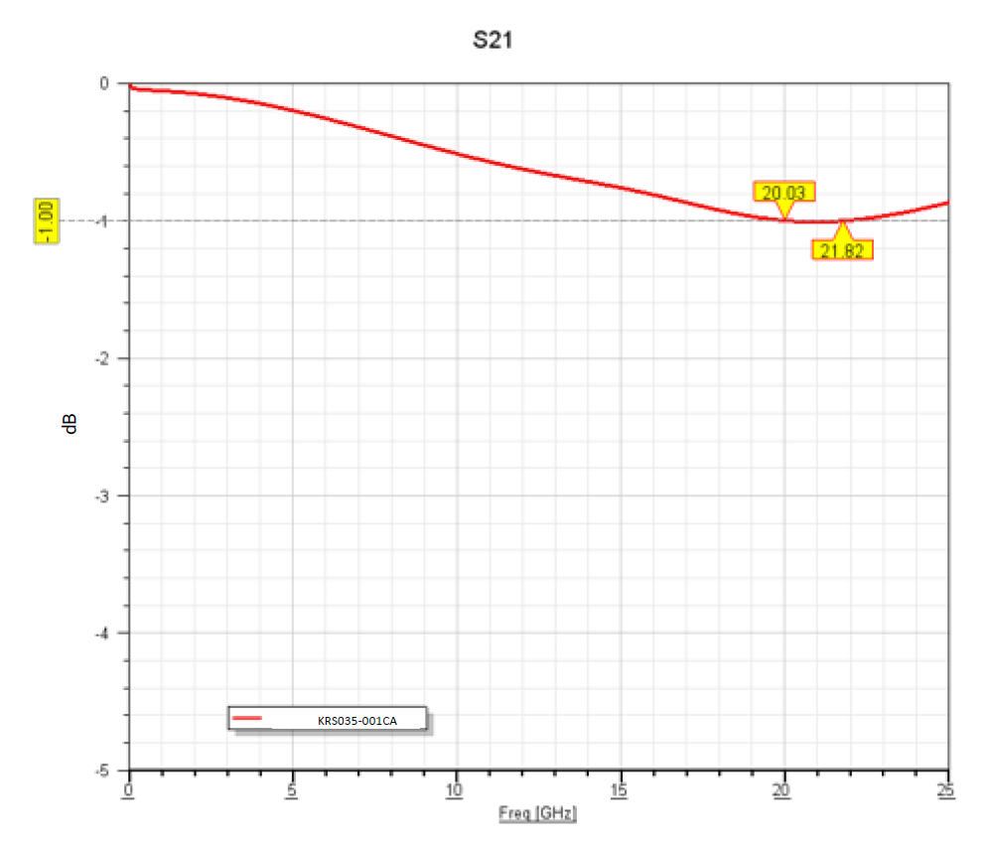
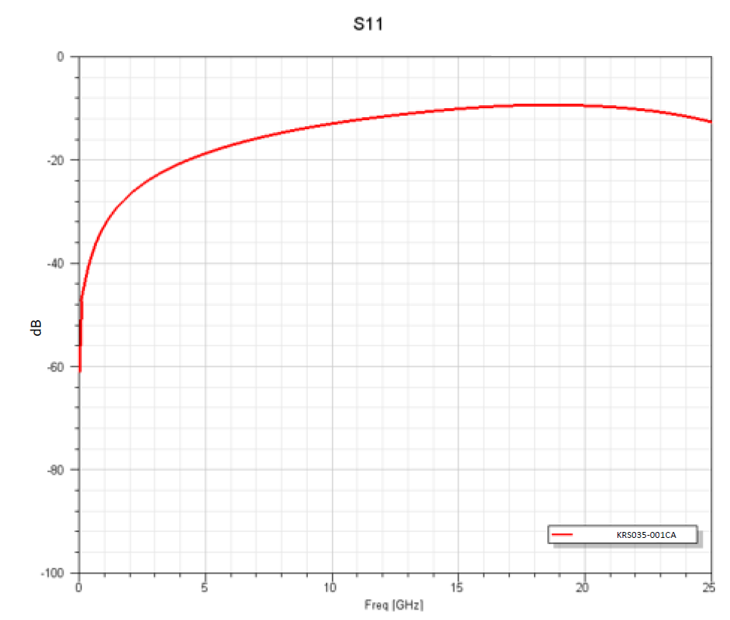
※ S2Parameter simulation data
Pin name | IVB-SAR-545-026-A241-00
Test code | KRS035-001CA
Pitch [mm] | 0.35
Test length [mm] | 5.05
Relative permittivity of socket (Er) | 4.0
Arrange | GSG
-1dB@ [GHz] | 20.03

Slide 6
Thank you.

